Slide 1
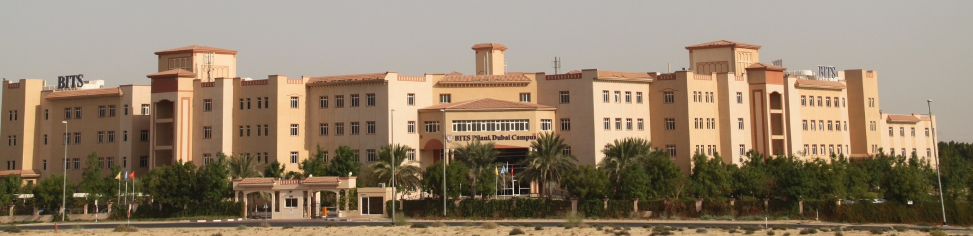
CS F301: Principles of Programing Languages

Slide 2
Contents
Programming Languages
What is a Programming Language?
Why study Programming Language Concepts?
Programming Domains
Characterize PL
Programming Paradigms
Role of PL
Language Implementation

Slide 3
Programming Languages
What are Programing Languages?
Way for humans to express their desire of getting some work done on a computer system.
Look at the distinction
Study a programming Language
Study the principles of programing languages
Study a programing Lang
CS F111 Computer Programming (C Lang), CS F213 OOP (Java + something), On your own ..
Study the principles of prog lang. (design of lang)
What features the lang should provide, underlying concepts of PL.
Make computing convenient or easy for programmers/people
Make efficient use of computing machines.

Slide 4
What is a Programming Language?
A tool for instructing machines
A means of communicating between programmers
A vehicle for expressing high-level designs
A notation for algorithms
A way of expressing relationships between concepts
A tool for experimentation
A means for controlling computerized devices

Slide 5
Why study Programming Language Concepts?
Increased capacity to express programming concepts
Improved background for choosing appropriate languages
Increased ability to learn new languages
Understanding the significance of implementation
Increased ability to design new languages
Overall advancement of computing

Slide 6
Programming Domains
Scientific applications
Business applications
Artificial intelligence
Systems programming
Scripting languages
Special purpose languages

Slide 7
Characterize PL
Gross distinction between programming language
Based on readability
Based on purpose (specific … general)
Machine level language
Assembly level language
High-level language (3GL)
Sometimes 4GL - fourth Generation Language

Slide 8
Programming Paradigms
Imperative Languages - action oriented, sequence of actions
Focus : Programmer tells how to do (Do exactly what is told)
Further Classifications
Procedural: Fortran, Pascal, C, Algo
Object Oriented: Simula, Smalltalk, C++, Java
Scripting Lang: AWK, Perl, Python
Declarative Languages
Focus: Programmer tells what is to be done (Do what is meant)
Further Classifications
Functional : LISP/Scheme/Haskel, symbolic data processing .
So popular that even h/w LISP Processor was made.
Logic: Prolog, logic reasoning
SQL
Sequential and concurrent

Slide 9
Language Design Influences: Computer architecture
We use imperative languages, at least in part, because we use von Neumann machines
John von Neuman is generally considered to be the inventor of the "stored program" digital computer - the class to which most of today's computers belong.
CPU+memory which contains both program and data
Focus on moving data and program instructions between registers in CPU to memory locations

Slide 10
Machine Lang.
00000010101111001010
00000010101111001000
00000011001110101000
Can you tell what this code fragment does?
Can it be executed on any machine?
Is it general purpose?
von Neumann Architecture.
There is no distinction between code and data
They are stored in the same memory..

Slide 11
Assembly Lang.
LD R1, A
ADD R1, B
ST R2, C
… real assembly used mnemonics (names and symbols)
Have to do your own indexing
Better than machine code, still low level.

Slide 12
Random Acess Machine (RAM)
Memory: addresses, contents
Program: instructions
input/output:(files)

Slide 13
High Level
Readable familiar notations
machine independence
Programming model/semantics not limited to machine arch
Provides data and control flow abstractions
availability of program libraries
consistency check (check data types)
Need for Translators
Compilers / Interperters
Initially compiler generated code was slower that assembly code.
Now its better than human written assembly code
Eg i = i + 1; i++;

Slide 14
Bugs
Programming testing can be used to show the presence of bugs, but never their absence! - Dijkstra
Programming Languages can help
Readable and understandable
Organize such that parts can be understood

Slide 15
Early Prog Lang
FORTRAN - J. Backus (IBM) 1954 - Formula Translator - For Numerical computing - Focus : Efficiency | ALGOL - J. Backus (IBM), F. Bauer (TU), 1958 - Algorithmic Language - Algo -> Programs - Focus: Clarity and Elegance of Programs
LISP - J. McCarthy (MIT), 1958 - List Processor - For symbolic computing - Focus : Absractions | COBOL - G. Hopper (US Navy), 1959 - Common Business Oriented Language - For data processing (Payroll) - Focus : English like..
FORTRAN, LISP, COBOL : Still used
ALGO as such not used, highly influenced its successors (Pascal)

Slide 16
Role of PL
PL must be Turing-Complete : anything computable must be capable of being expressed in the PL.
PL must be implementable on existing hardware platform
Art (science) of programming is organizing complexity
Must organize in such a way that our limited powers are sufficient to guarantee that the computation will establish the desired effect
Dijkstra - structured programming, sometimes referred to as goto-less programming (Single Entry, Single Exit – Sequence, Selection, Repetition)

Slide 17
What make a “good” lang
Syntax close to what we are used to
Readability
Expressible: while loop instead of if/goto stmt
Reliability: Error checking.
Detect use of uninitialized variables
Type checking, int_var = float_var ?
Array bounds (C vs Java)
Testing support.

Slide 18
Language Implementation
Processor executed only machine code.
High Level Lang: Need for lang translators ( 3 forms )
Compiler
Source code it translated into machine code (all at once)
Allows for compiler optimizations because the whole program is analyzed,
Unaware of runtime info : Compute Arch H/W optimizations.
Distribute executable (not source code)
Slow: edit-compile-test cycle. Compilation time can be large.
Resulting executable can be run efficiently.
Interpreter: Machine is brought up to the language
Executed one statement at a time.
Rapid development : edit-test cycle
Dynamic typing.
Virtual Machines:Combine the Plus points of Compiler/Interpreter

Slide 19
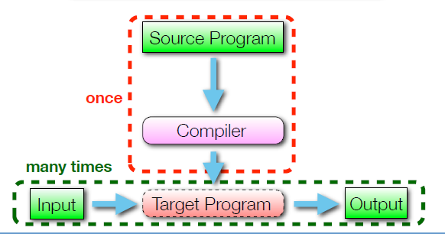
Language Implementation
Target program is machine code. (can be assemble: gcc –S)
Target program can also be C code
Cfront (Originally: C++ code was translated to C Code)
Target code can be portable machine code
Java byte code
Python byte code ??

Slide 20
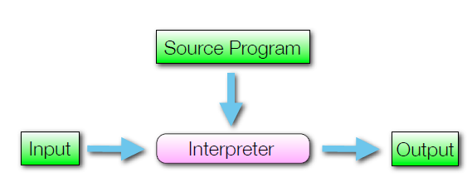
Language Implementation
Each run (of source program) is on the fly translation.
Interpreter take the source prog and actual input
Slower that compilation:
Translation done each time the prog is run.
Dynamic typing.
Same variable can be a integer variable for time and then a string.
Allows programs to be changed “on the fly” and run

Slide 21
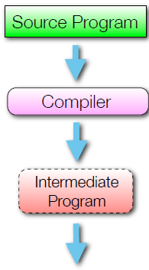

Language Implementation
Platform independence.
Interpreting HLL is slow
Compile: HLL to low level machine independent byte code.
Interpret byte code : faster than interpret HLL
Explicit Compilation
Java: $javac prog.java
Implicit Compilation
Python: $python prog.py
First time the prog is run its interpreted
Subsequent runs : the cached byte code is executed.

Slide 22
Reference
Chapter 1, Ravi Sethi, "Programming Languages: Concepts and Constructs" 2nd Edition by Addison Wesley, 2006.

Slide 23
Thank you

